Slide 1
Project FRP
File created on: 10/31/2025 8:36:04 AM

Slide 2
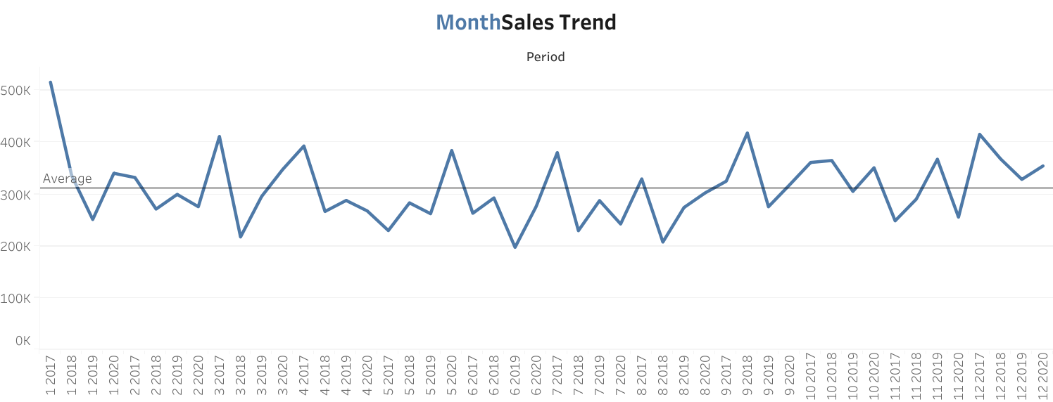

Slide 3
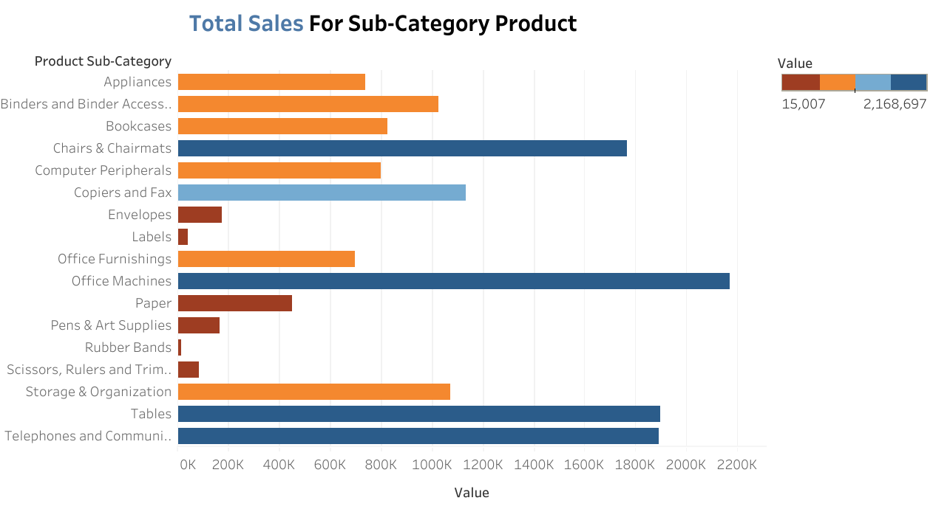

Slide 4
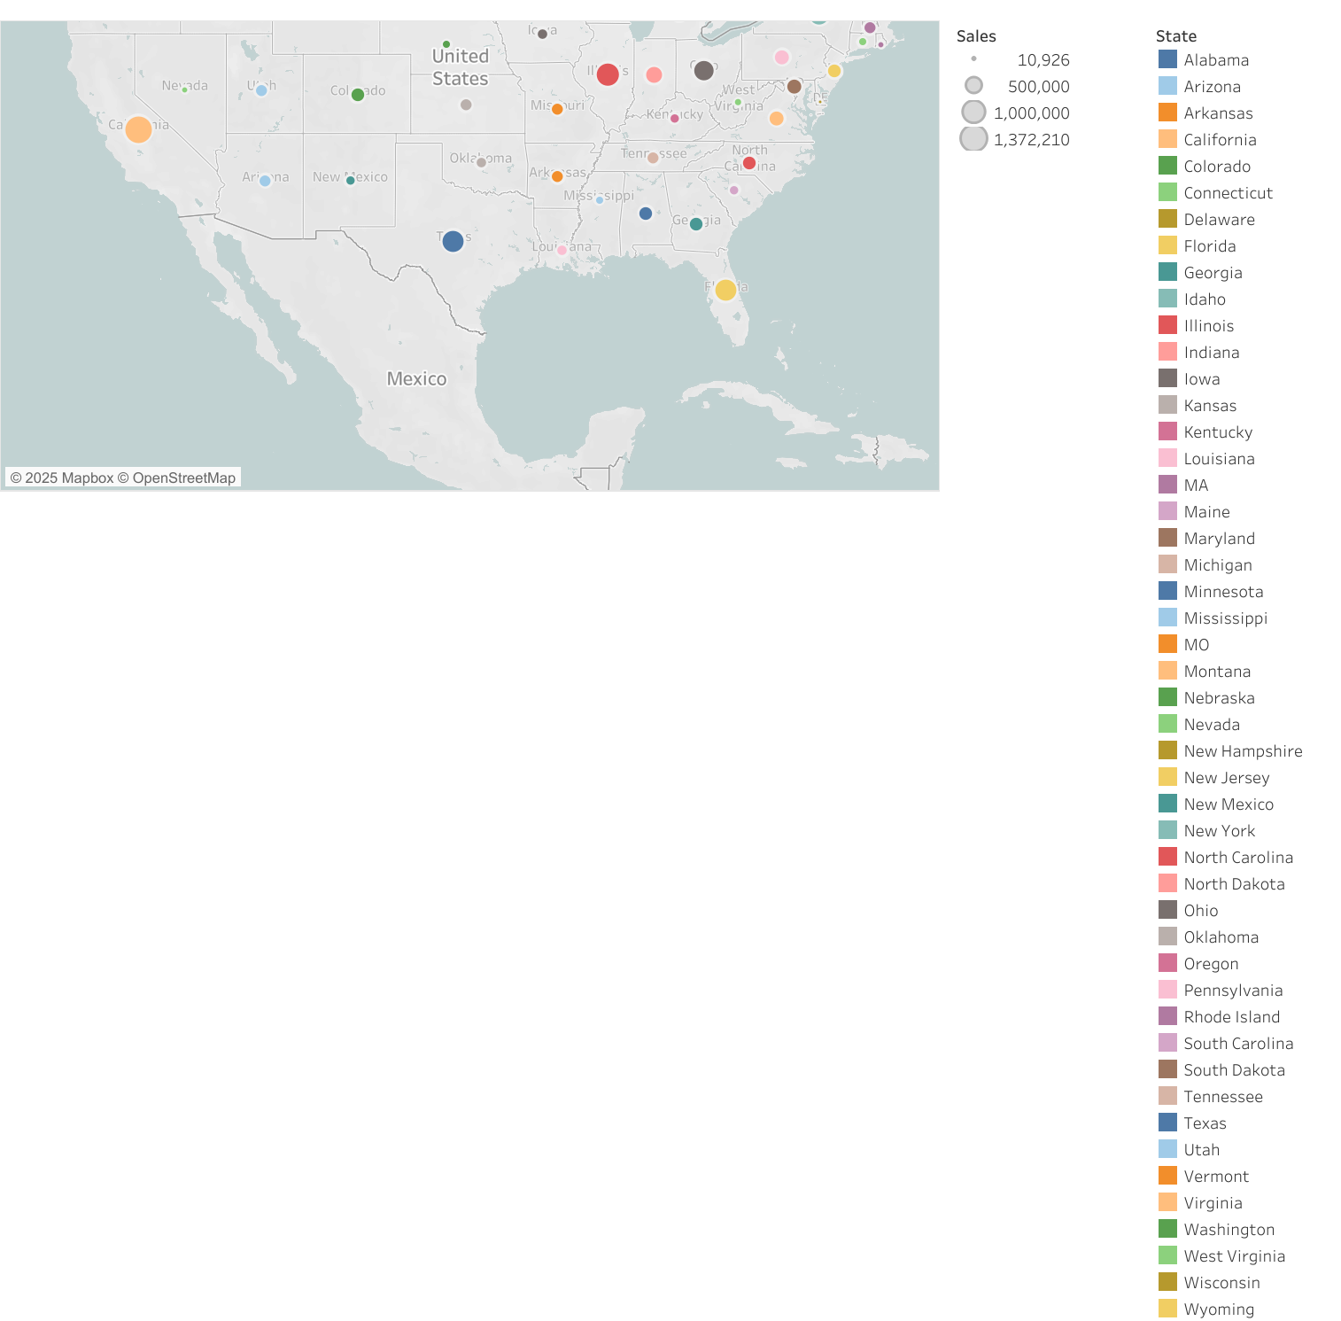

Slide 5
